Slide 1
Statistics for linguist(ics)
2022-11-08
Adam J.R. Tallman

Slide 2
From last lecture
Data types in R
Reading files into R
Cleaning data in R
Plotting in ggplot
Subsetting in base R and in tidyverse

Slide 3
For today’s lecture
T statistic
Z statistic
Standard deviation
Variance
Probability density distributions / functions
P values
Confidence intervals
A little bit about Frequentism

Slide 4
Concepts
Main effect
P value
ANOVA/ MANOVA
Chi-squared
F statistic
Some technical notations (x^2, etc.)
Lots of domain specific concepts

Slide 5
Preparation
You need to download two databases
Araonavowels
Chacobo forced task
You need to install the following packages
rlist()
tidyverse()
reshape()
Nhstplot()

Slide 6
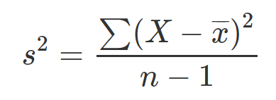
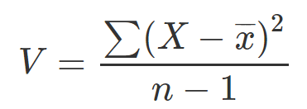
Sample variance

Slide 7
Variance
What happens to the variance if n increases?
What happens to the variance if values are more spread out?
What is the relationship between variance and the standard deviation?

Slide 8
Variance
What happens to the variance if n increases?
Variance decreases
What happens to the variance if values are more spread out?
Variance increases
What is the relationship between variance and the standard deviation?
The variance is the standard deviation squared.

Slide 9
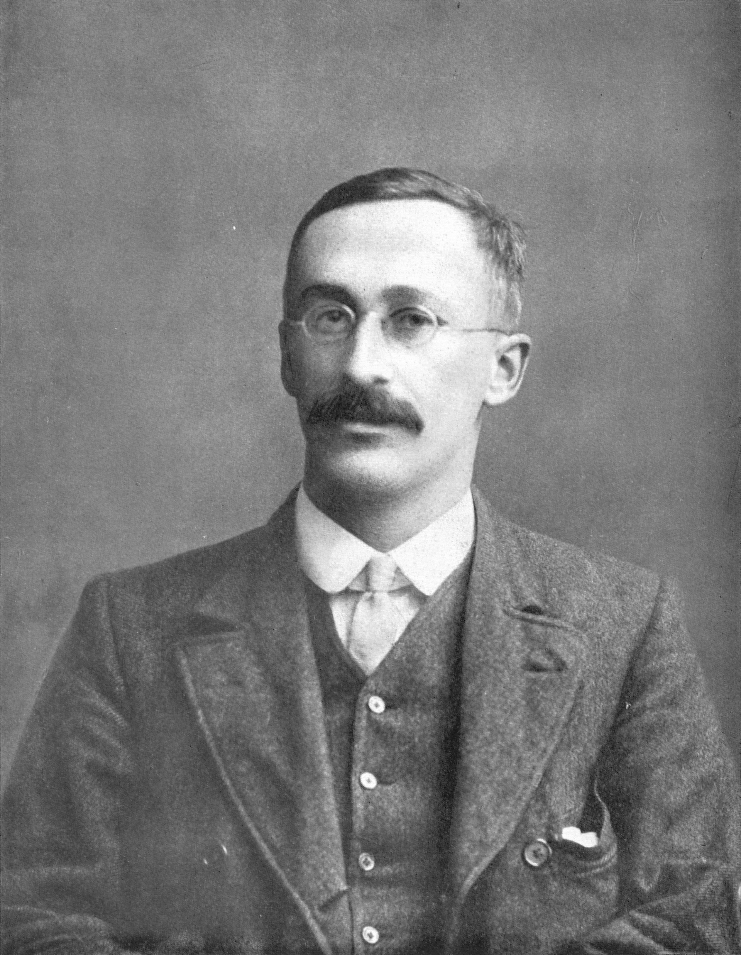
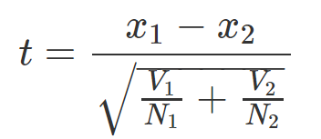
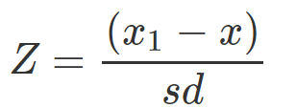
t statistic
William Sealy Gosset
Similar but not the same (z statistic)

Slide 10

T statistic
What happens to the t statistic as the difference between the means of two groups increase?
What happens to the t statistic as the variance increases in either group?
What happens to the t statistic as the sample size of either group increases?

Slide 11
T statistic
What happens to the t statistic as the difference between the means of two groups increase?
It depends: if x1 is larger than x2 then t will increase, if x1 is smaller than x2, then t will decrease. But importantly, t will get further away from zero in one of the two directions.
What happens to the t statistic as the variance increases in either group?
The t statistic will get closer to zero
What happens to the t statistic as the sample size of either group increases?
The t statistic will get closer to zero.

Slide 12
Probability
What’s a probability?
Probabilities assign numbers to possibilities.
Bayesian
Degree of belief
Frequentist
Long run frequency over an infinite amount of trials

Slide 13
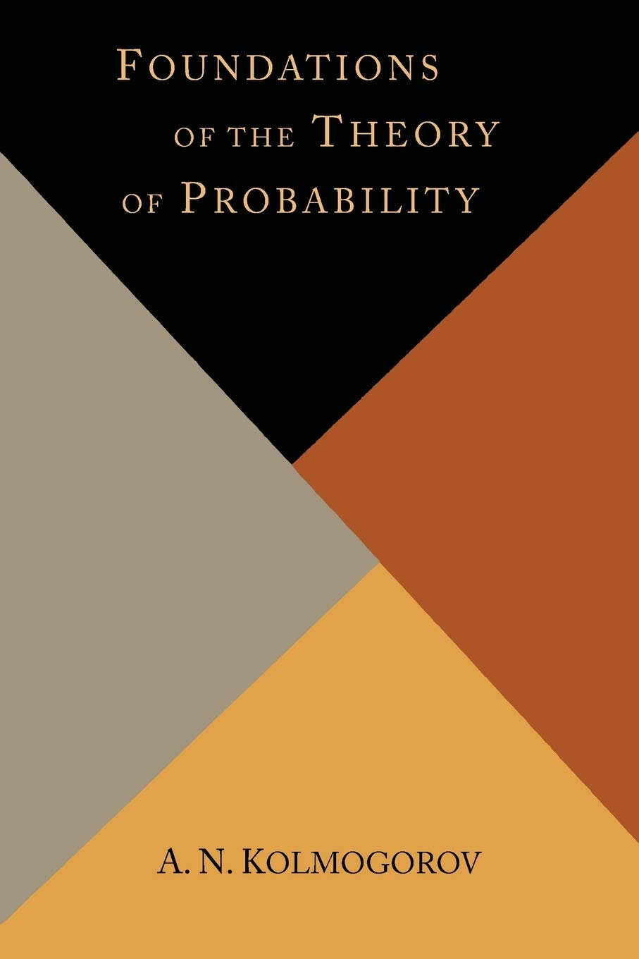
Probability
Axioms of probability
1. A probability value must be non-negative (i.e., zero or positive).
2. The sum of the probabilities across all events in the sample space must be 1
3. For any two mutually exclusive events, the probability that one or the other occurs is the sum of their individual probabilities.

Slide 14
Probability distributions
A probability distribution is a list of all possible outcomes and their corresponding probabilities.
What’s the probability distribution of a coin toss?

Slide 15
Probability distributions
“A probability distribution is a list of all possible outcomes and their corresponding probabilities.”
(Kruschke 2011: 30 Doing Bayesian Data Analysis)
What’s the probability distribution of a coin toss?
p and 1 – p
If its fair its just 0.5 and 0.5

Slide 16
Probability distributions
“A probability distribution is a list of all possible outcomes and their corresponding probabilities.”
(Kruschke 2011: 30 Doing Bayesian Data Analysis)
What’s the probability distribution for the number of calories you might consume in a day?
What’s the probability distribution for the duration of a vowel?
What’s the probability distribution for a word being used in a given syntactic construction?

Slide 17
Probability distributions
Probability mass: when we are talking about discrete outcomes.
Probability density: when we are talking about continuous outcomes.
There’s a conceptual difference here: its easy to talk about the probability of specific outcomes which are discrete … but this isn’t true when the values are on a continuum.

Slide 18
Probability distributions
What’s the probability that you will consume exactly 2000.00000…. calories?
Pretty much zero.
What’s the probability that a vowel will be exactly 80.00000…. milliseconds long
Pretty much zero.
Instead, we talk about intervals (e.g. probability of 2000 or higher, probability of vowel being between 70 and 90 milliseconds).

Slide 19
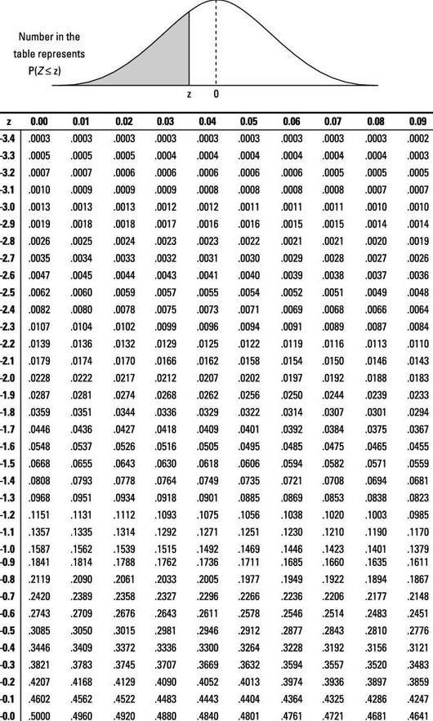
P values
You calculate p values from the t statistic.
And you used to have to look up the results on a chart like this.

Slide 20
P-value
What is a p-value?
Its an interval probability in relation to a hypothetical distribution that imagines you performed an experiment forever (or gathered data forever).
How is it calculated?
You need a t statistic (z statistic) and a probability distribution (a t distribution if you are doing a t test) -imaginary hypothetical distribution of values we assume if there was no difference between your groups or no relationship between your variables.
Why is it calculated this way?
There’s a complicated historical reason for this - but basically you are calculated the probability of your data given a null hypothesis.
You are not doing the more intuitive thing of calculating the probability of your hypothesis given your data.

Slide 21
Confidence intervals
”A confidence interval shows the likely range in which the mean would fall if the sampling exercise were to be repeated"
(Crawley 2015:61)
Interval gets wider as unreliability goes up.

Slide 22
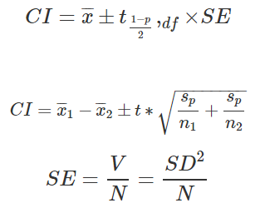
Confidence intervals
Every time you see this plus-minus symbol in statistics, it means we are calculating an interval.

Slide 23
Confidence intervals
What happens to the confidence intervals as the variance increases?
What happens to the confidence intervals as the sample increases?
What happens to the confidence intervals as the difference between two groups increase?

Slide 24
Confidence intervals
What happens to the confidence intervals as the variance increases?
They widen
What happens to the confidence intervals as the sample increases?
They narrow
What happens to the confidence intervals as the difference between two groups increase?
They neither widen nor narrow, but the interval just increases its min and max values.

Slide 25
Confidence intervals
Some argue that confidence intervals are more informative than p values.
``On all counts, the confidence intervals seems clearly superior to the traditional significance testing approach. Significance tests focus on just one null hypothesis value, whereas confidence intervals display the entire range of hypothetical values of a parameter that cannot be rejected. Although the confidence interval can be used as a significance test, there is no need to it to be used that way, and in fact such an interpretation willfully ignores most of the information being provided by a confidence interval... Confidence intervals enhance comparisons between research replications and enable researchers to move toward cumulative knowledge based on replications. Significance tests are not readily able to do this and, as has been argued by various authors (...), significance tests may actually blind researchers to cumulative evidence." (Smithson 2003: 12)

